Slide 1
LIVE BLOG ANALYSIS
PROJECT BY
TEAM 10
Harshad Pardeshi
Prithvi Kamath
Tejesh Rathi

Slide 2



Team 10
Harshad Pardeshi
Prithvi Kamath
Tejesh Rathi

Slide 3
agenda
Data Wrangling and Pre-processing
Programmatic Data Download – Live API
Data Cleaning and Pre-processing
Exploratory Data Analysis
Text Analysis using TF-IDF
Classification
Clustering using LDA and K-Means
Luigi Pipelining

Slide 4
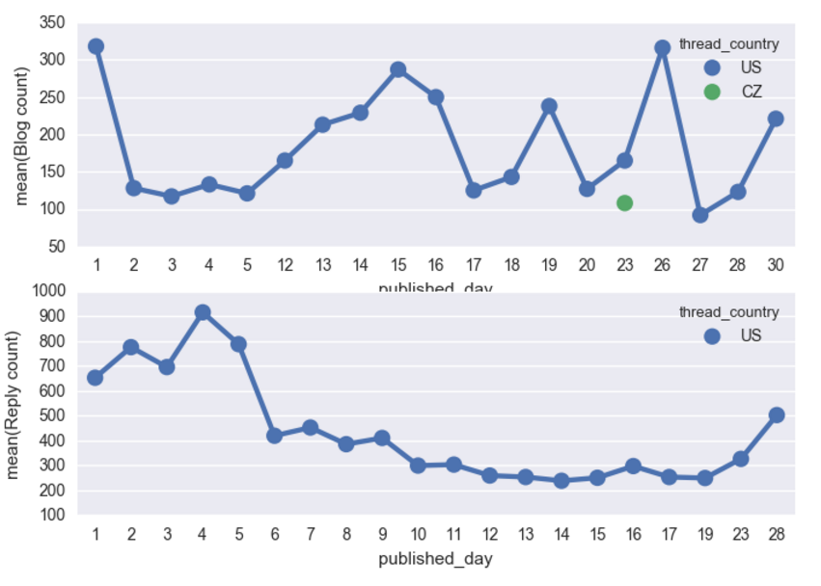
EXPLORATORY DATA ANALYSIS
Multi – json file with huge text data as blog or message board
Cleaning text data using stemming, stop words and tokenizer
Country-wise blog contribution and response over a month

Slide 5
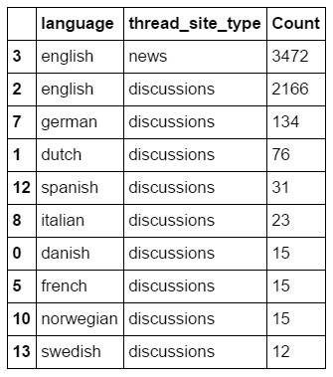
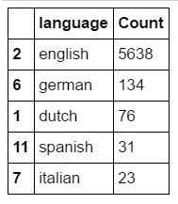

Most preferred language for writing a blog across Countries

Slide 6
TF-IDF
Created a algorithm based on below features:
Tf(word,blob)
N_containing(word,bloblist)
Idf(word,bloblist)
Tfidf(word,blob,bloblist)

Slide 7
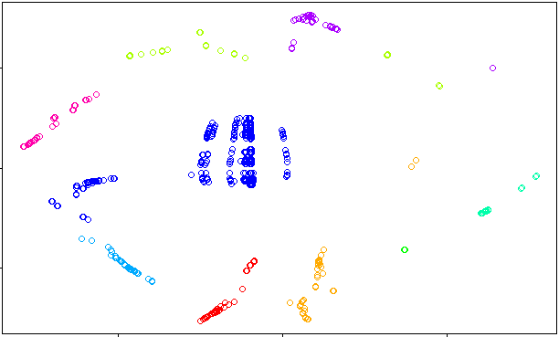
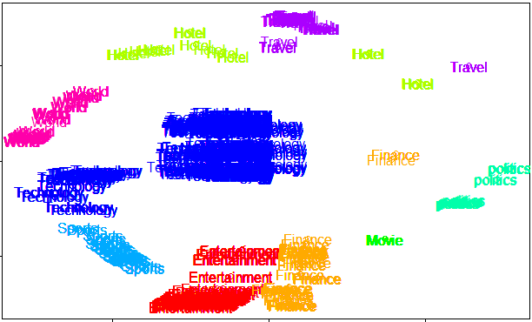
T-SNE
Non-linear dimensionality reduction algorithm to find patterns in data by identifying clusters in the data

Slide 8
CLassification
Based on the keyword entered by the user, taking the live data to get the relevant and not-relevant topics
Created models and implemented on three models – Logistic Regression, Neural Networks and Random Forest
Random Forest was found the best based on the accuracy of 84%
Implemented the same on Microsoft Azure Machine Learning Studio and got an approximate accuracy of 85%, similar to our best model
The classification data which is relevant is then given as input data which is clustered further.

Slide 9
clustering
We performed clustering based on two methods:
LDA Algorithm
K-Means Clustering
LDA Algorithm:
Tokenized and stemmed words
Use Bag of words function using Gensim LDA model
Form 3 clusters based on TF-IDF score
Comparison with Bag of words to assign it to the matched blog type
K-Means Clustering:
Remove the stop words and stem the words
Create Document term matrix and find Euclidean distance
Divide the cluster into 4 types as suggested by bend curve

Slide 10
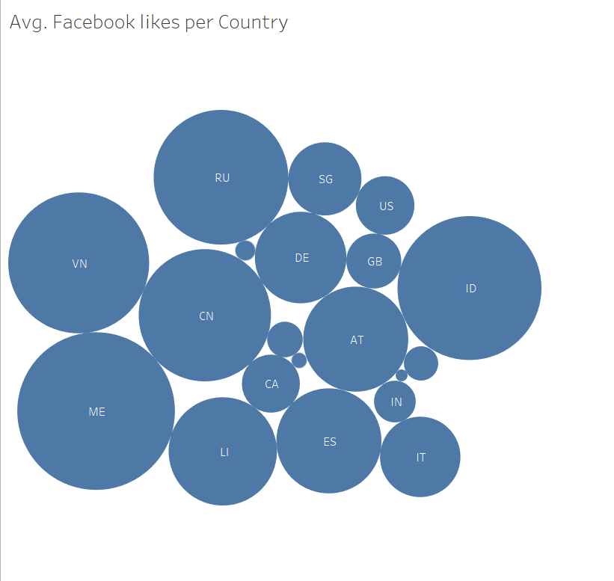
Visualization - tableau
1) Average Facebook likes per Country

Slide 11
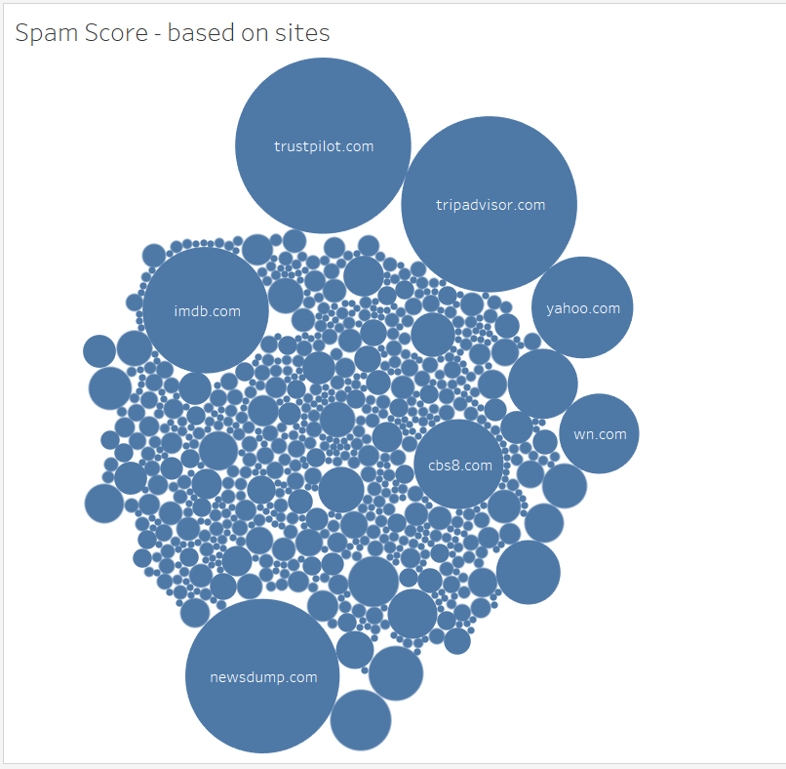
2) Spam Score count based on sites

Slide 12
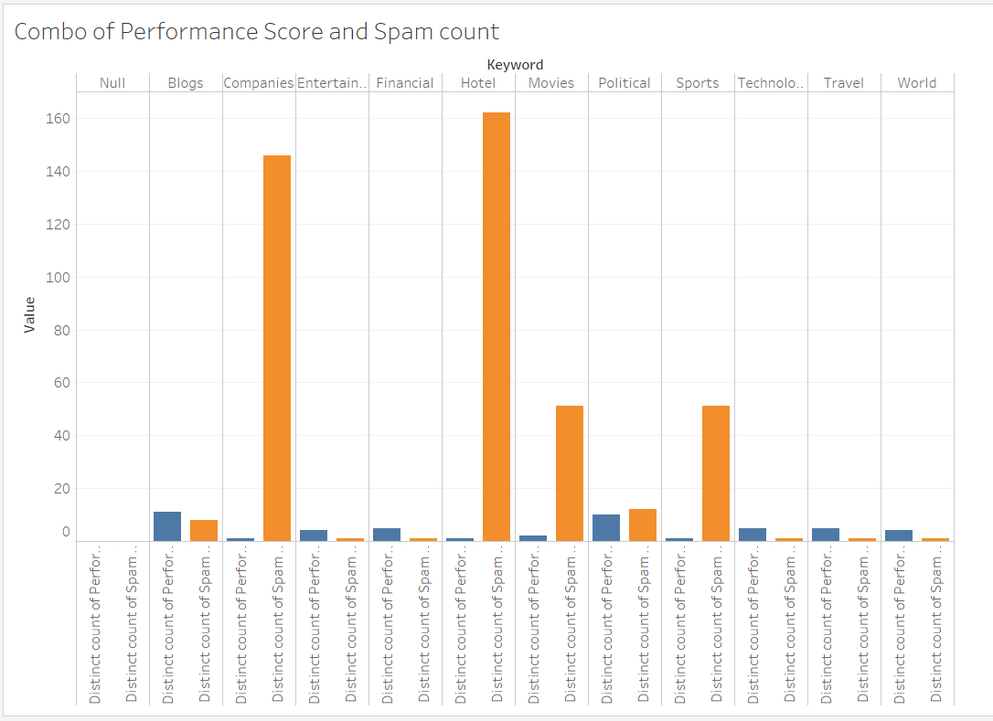
3) Comparison of multi-measure features - performance score and spam score

Slide 13
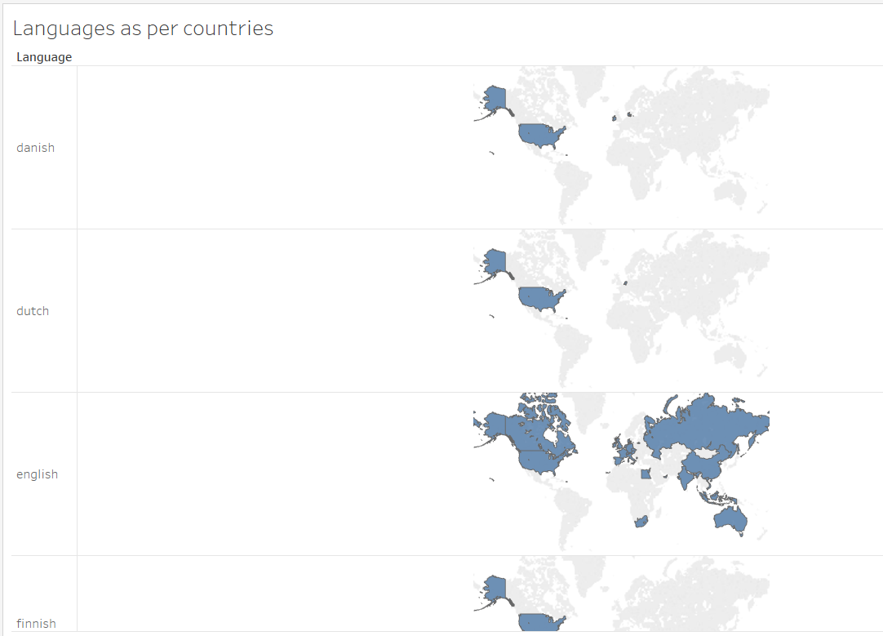
4) Languages used for blogs and message boards as per the country

Slide 14
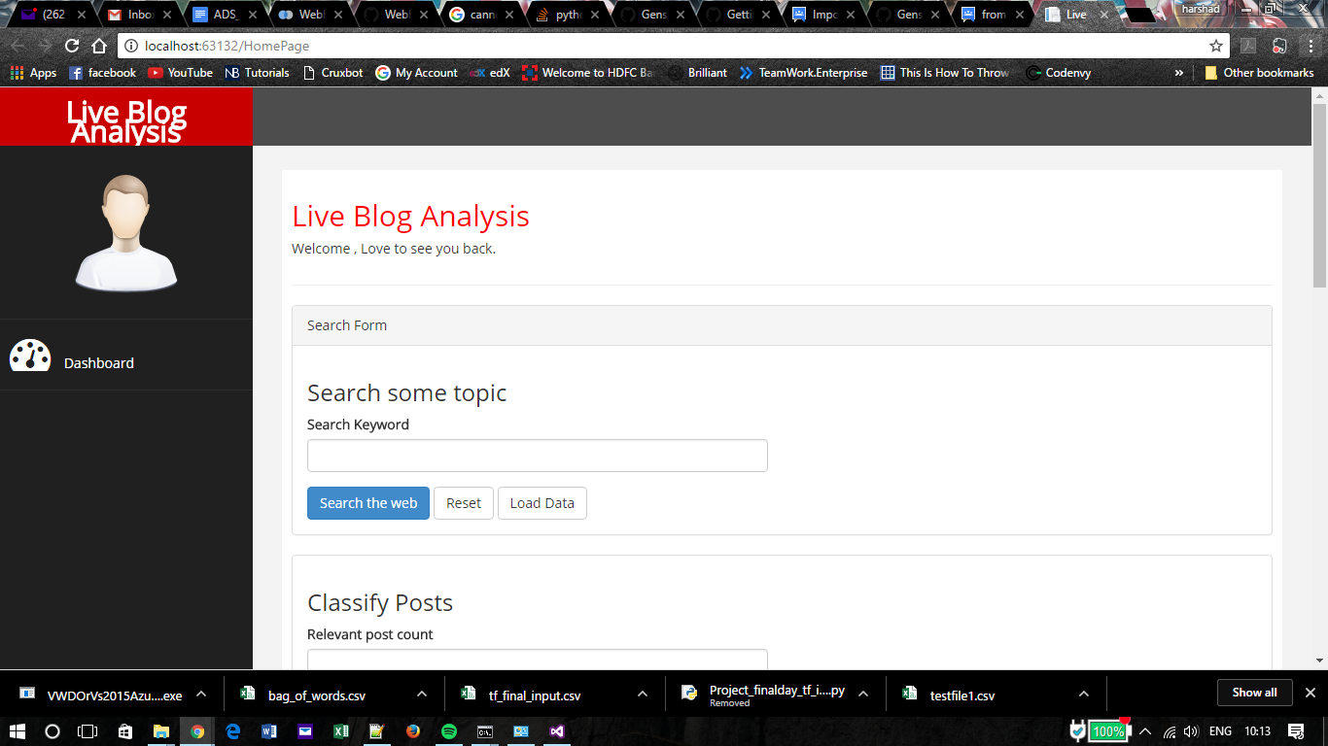
USER INTERFACE

